Slide 1
: an introduction
Presentation based on Software Carpentry Foundation course: https://swcarpentry.github.io/git-novice/

Slide 3
Version control system

Slide 4
Version control system
Tool that keeps track of changes and helps us version and merge our files
It allows you to decide which changes make up the next version, called a commit, and keeps useful metadata about them.
The complete history of commits for a particular project and their metadata make up a repository.
Repositories can be kept in sync across different computers facilitating collaboration among different people.

Slide 5
Better than mailing files back and forth because:
Nothing that is committed to version control is ever lost
It’s always possible to go back in time to see exactly who wrote what on a particular day
As we have this record of who made what changes when, we know who to ask if we have questions later on, and, if needed, revert to a previous version
Useful for collaborative works but also to your individual research (keeping a record of what was changed, when, and why is extremely useful)

Slide 6
Make GitHub recognize you
$ git config --global user.name "USER"
$ git config --global user.email "YOUR EMAIL@EMAIL.COM"
Creating a repository
$ mkdir Test
$ cd Test
$ git init # Initialize empty Git repository

Slide 7
Tracking Changes
Create a file in your test folder
$ nano labmeeting.txt
Type something inside “Every Tuesday at 10:30 am” (to get out from the text editor: control+X Y enter)
Check the status and Git will tell that it’s noticed the new file:
$ git status
Tell Git to track a file using git add:
$ git add labmeeting.txt
Check that the right thing happened with git status again
$ git status

Slide 8
Committing
Git now knows that it’s supposed to keep track of labmeeting.txt, but it hasn’t recorded these changes as a commit yet. To do so run:
$ git commit -m "Notes on lab meetings”
Check status again and see that there’s nothing to commit
$ git status
Access project’s history using:
$ git log

Slide 9
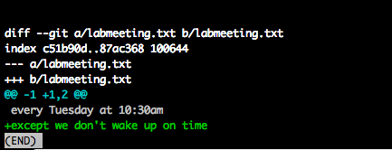
Modifying an existing file
$ nano labmeeting.txt
except we don't wake up on time
$ cat labmeeting.txt
Review changes with git diff
$ git diff

Slide 10
Committing a change in a file
If you check status, it’s going to ask you to use git add and git commit
Then:
$ git add .
$ git commit -m “exceptions"

Slide 11
Always git add before git commit
If you think of Git as taking snapshots of changes over the life of a project:
git add specifies what will go in a snapshot (putting things in the staging area)
git commit then actually takes the snapshot, and makes a permanent record of it (as a commit)

Slide 12
Exploring history and deleting last commits
The most recent commit of the working directory can be refered by the identifier HEAD
To check the difference between older commits:
$ git diff HEAD~1 labmeeting.txt
To get rid of the last commit
$ git checkout HEAD~1 labmeeting.txt
You can put things back with:
$ git checkout -f master labmeeting.txt

Slide 13
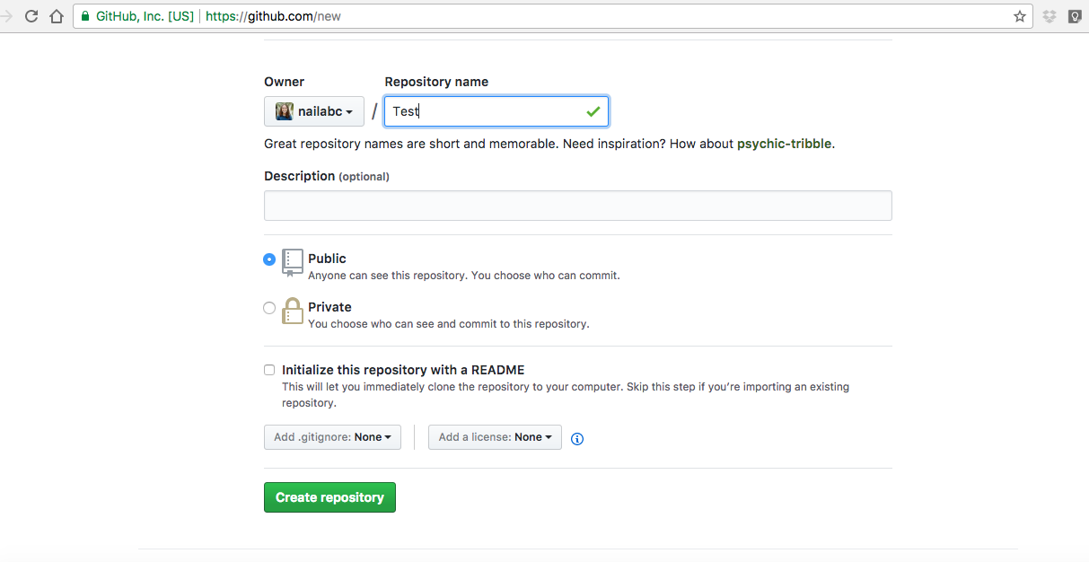
Uploading the repository

Slide 14
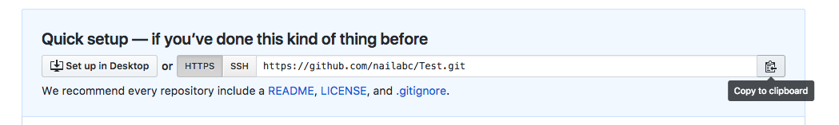
Copy the HTTPS address of the repository
You will paste it in the command line: go into the local Teste repository and run:
$ git remote add origin https://github.com/nailabc/Test.git
Check that the command has worked with:
$ git remote –v
Push the changes from your local repository to the repository on GitHub:
$ git push origin master
You can also pull changes from the remote repository to the local one:
$ git pull origin master

Slide 15
Summary of Git commands
$ git clone REPOSITORYURL
$ git branch
$ git status
$ git init
$ git log
$ git diff
$ git add
$ git commit
$ git checkout
$ git pull
$ git push

Slide 16
